Slide 1

Digital Signatures

Slide 2
Definition
A digital signature or digital signature scheme is a type of asymmetric cryptography used to simulate the security properties of a signature in digital, rather than written, form.
Digital signature schemes normally give two algorithms, one for signing which involves the user's secret or private key, and one for verifying signatures which involves the user's public key. The output of the signature process is called the "digital signature."

Slide 3
What’s Digital Signing?
There are many ways to sign a digital document, but we will only present the standard Digital Signing protocol.
Digital signing is used to provide trust that the content has come from the claimed source and has not been altered.
There are many ways to sign a digital document, but we will only present the standard Digital Signing protocol .Digital signing is used to provide trust that the content has come from the claimed source and has not been altered.

Slide 4

Why Digital Signatures?
To provide Authenticity, Integrity and Non-repudiation to electronic documents
To use the Internet as the safe and secure medium for e-Commerce and e-Governance
Notes:
One cd rom=one tree

Slide 5

History
In the famous paper "New Directions in Cryptography", Whitfield Diffie and Martin Hellman first described the notion of a digital signature scheme, although they only conjectured that such schemes existed. Soon afterwards, Ronald Rivest, Adi Shamir, and Len Adleman invented the RSA algorithm that could be used for primitive digital signatures).
The first widely marketed software package to offer digital signature was Lotus Notes 1.0, released in 1989, which used the RSA algorithm.

Slide 6
How a message be send using Digital Signature

Slide 7
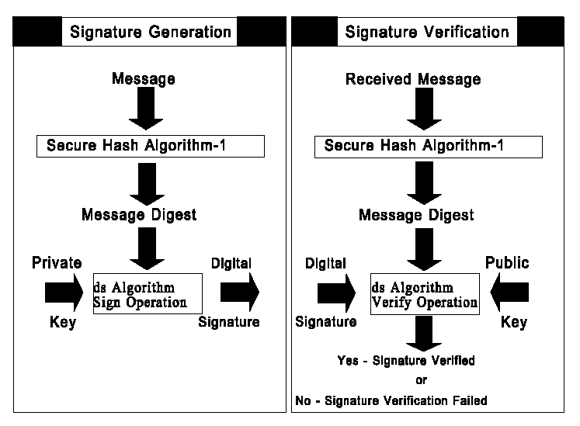
WORKING - Digital Signature Standard (DSS)

Slide 8

Signed Messages
Calculated
Hash
Message
Sent thru’ Internet
Message
+
signature
Message
+
Signature
if
OK
Signatures
verified
COMPARE
Hash
Signed
Message
SIGN hash
With Sender’s
Private key
Hash
Decrypt
Signature
With Sender’s
Public Key
Sender
Receiver

Slide 9
Digital Signature Technologies
PKI (Public Key Infrastructure)
Digital Certificates
RSA
MD5
PGP

Slide 10
Public Key Infrastructure (PKI)
Some Trusted Agency is required which certifies the association of an individual with the key pair.
Certifying Authority (CA)
This association is done by issuing a certificate to the user by the CA
Public key certificate (PKC)
All public key certificates are digitally signed by the CA

Slide 11
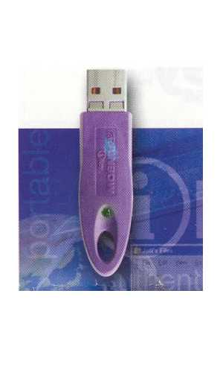

Digital Certificates & Certification Authority
User Certificate
Serial No.
Certificate
Database
User
Name &
other
credentials
User Name
Signed
by using
CA’s
private
key
User’s Email
Address
Certificate
Request
License issued
by CCA
User’s
Public Key
Publish
User’s
Public
key
User 1 certificate
User 2 certificate
.
CA’s Name
Certificate
Class
Public
Private
Public
Web site of CA
Validity
Digital
Signature
of CA
Key pair Generation

Slide 12
RSA
A public key crypto system invented by
RIVEST,SHAMIR and ADLEMAN (hence R.S.A. initial) in 1977.
Patented by RSA security but expired in 2000.
It relies on the complexity of factoring very large prime nos.

Slide 13
MD5
MD5 is another hashing algorithm created by RIVEST of MIT and one of creators of the algorithm. It produces a 128 bit message digest, and while quite popular.

Slide 14
PGP
Pretty Good Privacy(PGP) is one of the most widely used encryption for email . It was created by Phil Zimmermann in 1991 and is defined by the open PGP Working Group of the IETF standard RFC 2440. PGP is excellent software.

Slide 15
Benefits of digital signatures
Authentication :
Digital signatures can be used to authenticate the source of messages.
When ownership of a digital signature secret key is bound to a specific user, a valid signature shows that the message was sent by that user.
The importance of high confidence in sender authenticity is especially obvious in a financial context.

Slide 16
Integrity:
In many scenarios, the sender and receiver of a message may have a need for confidence that the message has not been altered during transmission.
Although encryption hides the contents of a message, Furthermore, there is no efficient way to modify a message and its signature to produce a new message with a valid signature, because this is still considered to be computationally infeasible by most cryptographic hash functions

Slide 17
Non-repudiation:
In a cryptographic context, the word repudiation refers to any act of disclaiming responsibility for a message.
A message's recipient may insist the sender attach a signature in order to make later repudiation more difficult, since the recipient can show the signed message to a third party (eg, a court) to reinforce a claim as to its signatories and integrity.

Slide 18


Paper signatures v/s Digital Signatures
Parameter | Paper | Electronic
Authenticity | May be forged | Can not be copied
Integrity | Signature independent of the document | Signature depends on the contents of the document
Non-repudiation | Handwriting expert needed Error prone | Any computer user Error free
V/s

Slide 19
Thank You

